Slide 1

Image
Notes:
[Sources]
- Πρότυπο: A4.M2 Πολυμέσα-Ήχος(2).pptx
[/Sources]

Slide 2
Today's lesson objectives
Convert an image to black and white
Highlight an area using desaturation
Use layers and an Alpha Channel for selective colour
Change the hues of a selected area
Notes:
[Sources]
- Θεωρία: pliroforiki_a_lykeiou_simeioseis_2023_2024(2).pdf, σελ. 79–82
[/Sources]

Slide 3
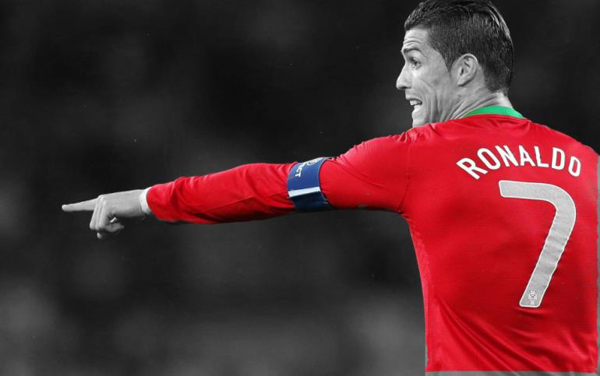
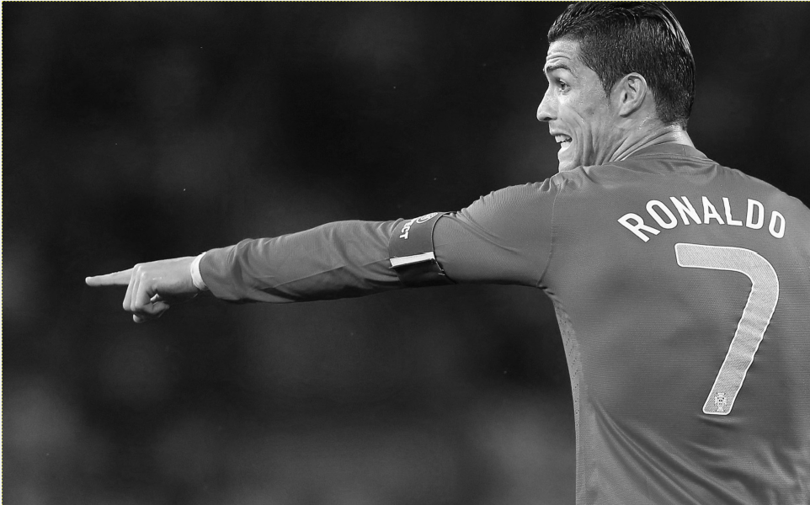
Removing colours
Open the image in GIMP.
Layer → Duplicate Layer
Colors → Desaturate
The upper layer becomes black and white, while the original remains in colour.
Notes:
[Sources]
- Θεωρία: pliroforiki_a_lykeiou_simeioseis_2023_2024(2).pdf, σελ. 81
- Ασκήσεις: pliroforiki_a_lykeiou_tetradio_ergasion_2023_2024(2).pdf, σελ. 59
[/Sources]

Slide 4
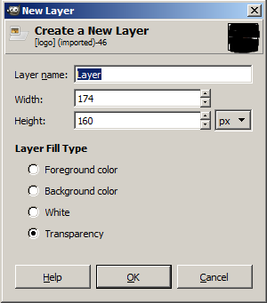
Layers and Alpha Channel
The duplicated layer is above the original image.
Layer → Transparency → Add Alpha Channel
The Alpha Channel enables transparency.
Use the Eraser to remove the grey area and reveal the colour from the layer below.
Notes:
[Sources]
- Θεωρία: pliroforiki_a_lykeiou_simeioseis_2023_2024(2).pdf, σελ. 81
[/Sources]

Slide 5
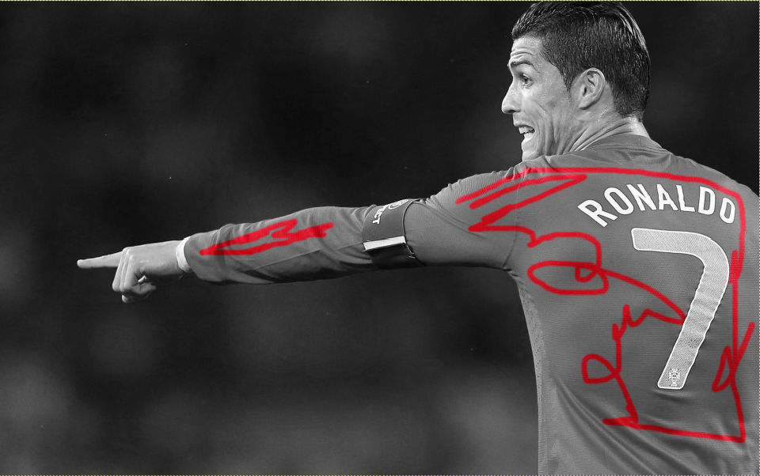
Selective colour
Notes:
[Sources]
- Ασκήσεις: pliroforiki_a_lykeiou_tetradio_ergasion_2023_2024(2).pdf, σελ. 59
[/Sources]

Slide 6
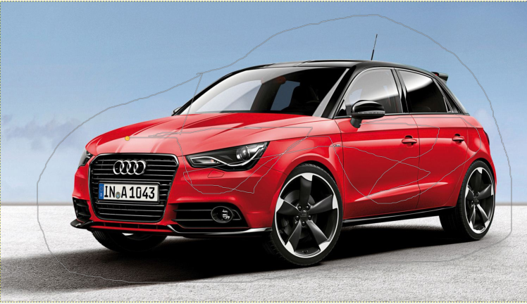

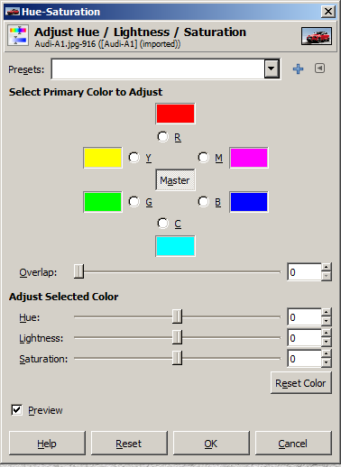
Changing the hue of a selected area
Use Foreground Select to draw roughly around the object.
Brush over the colours that you want to select.
Press Enter to complete the selection.
Use Colors → Hue-Saturation to choose the new colour.
Notes:
[Sources]
- Θεωρία: pliroforiki_a_lykeiou_simeioseis_2023_2024(2).pdf, σελ. 80 και 82
[/Sources]

Slide 7
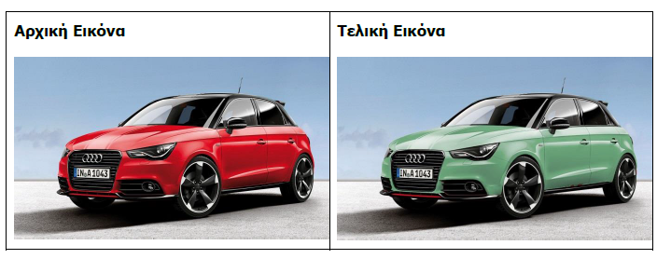
Changing hue

Slide 8
Completing the edit
Select → None
Remove the selection outline before checking the result.
File → Save
Save the project so that the layers are preserved.
Check that only the selected area has changed.
Notes:
[Sources]
- Ασκήσεις: pliroforiki_a_lykeiou_tetradio_ergasion_2023_2024(2).pdf, σελ. 59–60
[/Sources]

Slide 9
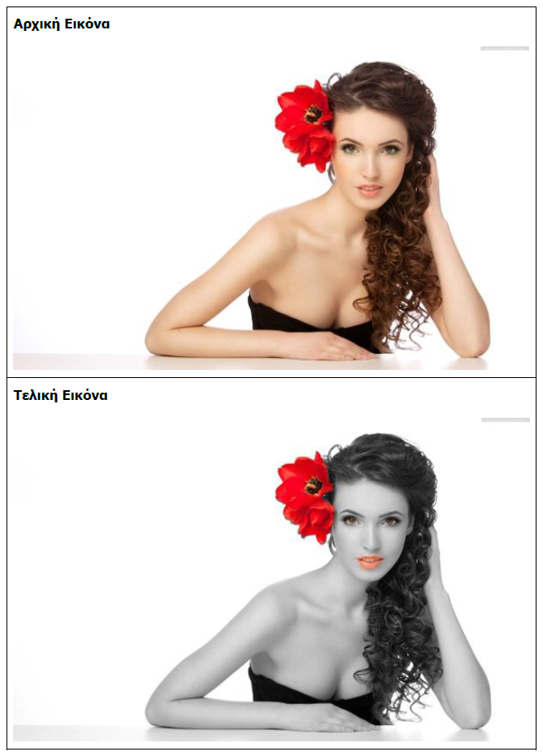

Slide 10
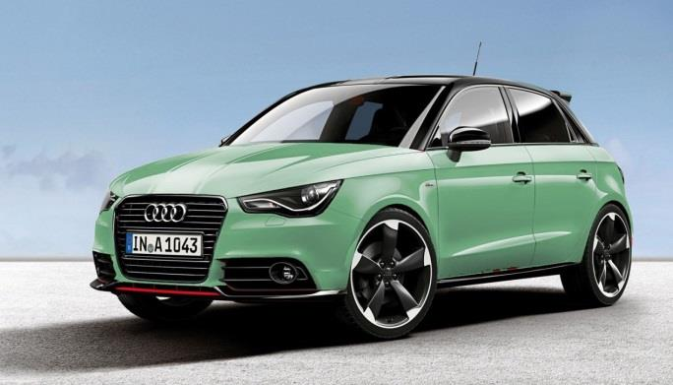
Exercises
In class – Worksheet A.4.M6 (pp. 59–60)
Activity A
Ronaldo.jpg: selective colour
Activity B
audi.jpg: change of hue
Notes:
[Sources]
- Ασκήσεις: pliroforiki_a_lykeiou_tetradio_ergasion_2023_2024(2).pdf, σελ. 59–60
[/Sources]

